Slide 1


Financial Portfolio Analysis
Market Value, Trend over next 12 Days and Returns

Slide 2

Agenda
Use case Discussion
Deliverables
Insights
Dashboard
Q&A

Slide 3


Use case
Analyze the financial portfolios of instruments and baskets using the given dataset and provide analysis report.
Tools Used
Microsoft Excel
Tableau
Checking for Data Quality issues & Finding the Base Date for analysis
22 Sept 2020
Instrument Price for 90% position
FX Rates
Current Positions

Slide 4
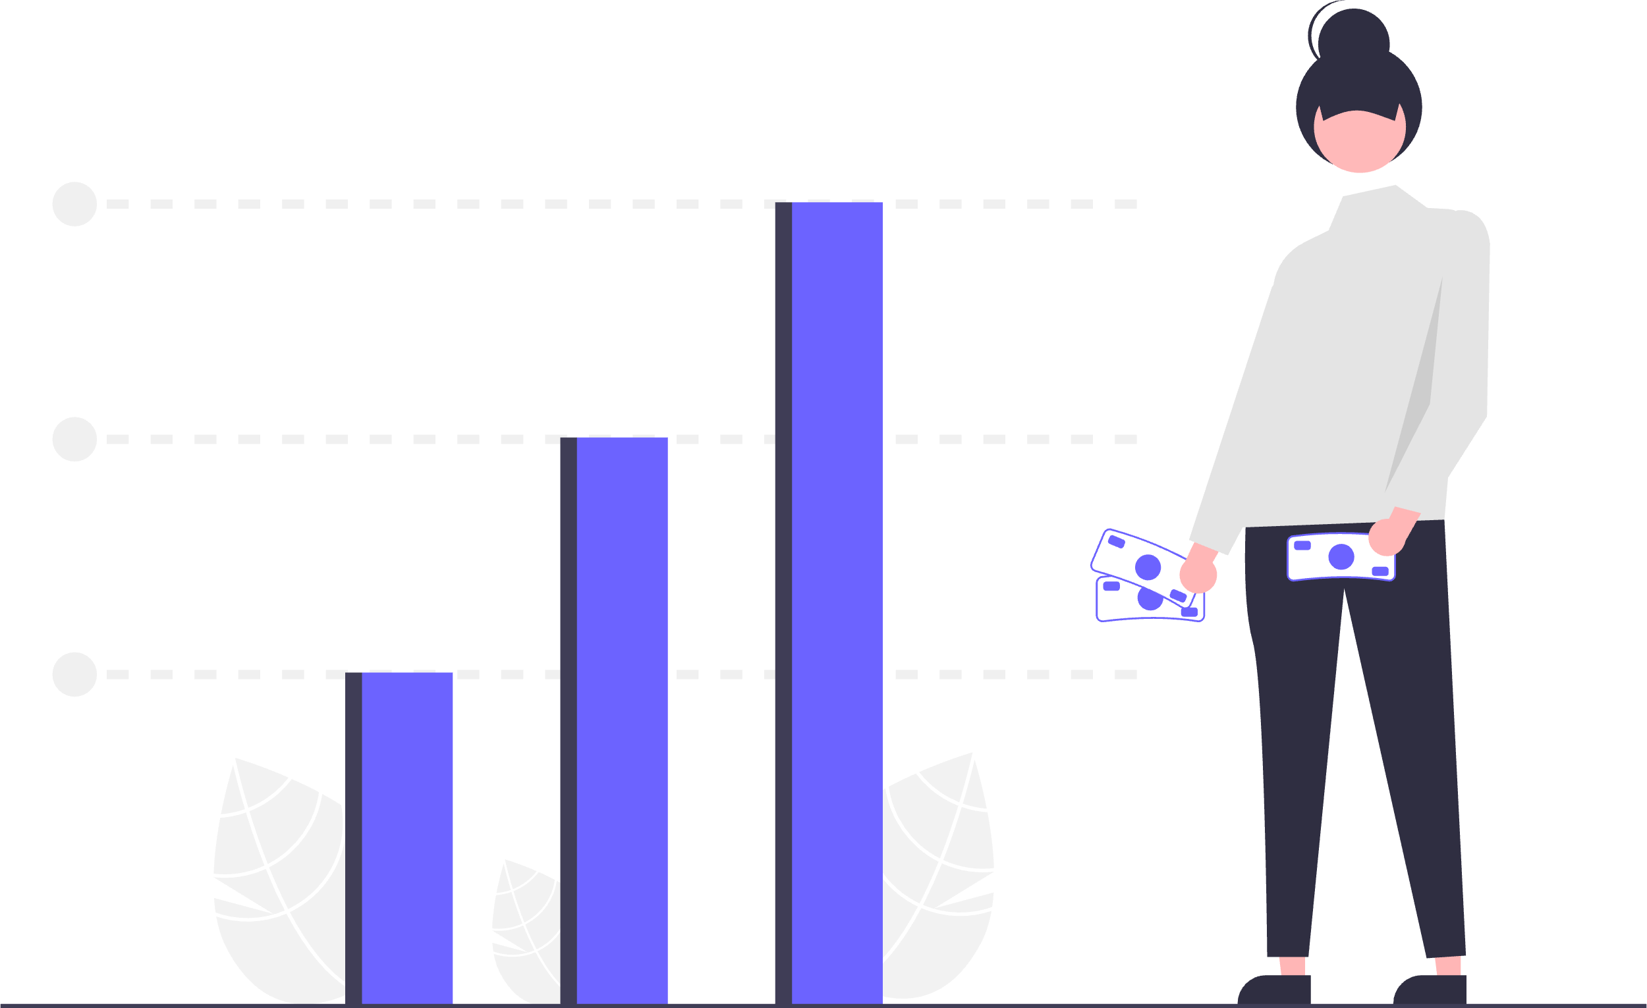
Created Samples for next 12 Days for Instrument Prices & FX Rates
Used Gaussian Noise Equation with -+10% for sample generation
Converted Instrument prices in USD, CNY & CHF to Euro for same currency equivalent instrument price.
Deliverables
Business Requirement Document.
Positions with a Market Value above 1 million EUR.
Interactive Dashboard with following features
Cumulative & Positional Level return of Portfolio / Positions for next 12 days .
Client can select date rate from 22-Sept-2020 to 04-Oct-2020 to see the return.
Filter Portfolio trend based on market value.
Visualize FX currency trend for USD , CHY & CHF.

Slide 5

Insights
Positions with a Market Value above 1 million EUR on 22 Sept 2020
Basket 1 Portfolio 1 14 M €
Basket 2 Portfolio 1 2 M €
Basket 3 Portfolio 1 1.4 M €
Basket 1 Portfolio 2 7M €
High-Return Investment Options Identified
Basket 1 Portfolio 1
AB - Allianceberstein Holding L.P. Units Portfolio 1
AAP - Advance Auto Parts Inc Portfolio 1
AA - Alcoa Inc. Common Stock Portfolio 1
Go to Dashboard

